Slide 1
An easy to use RPC framework
implemented by C++11/14
Yu Qi
qicosmos@163.com
Notes:
Hello everyone, i'm qiyu from China and today we're going to talk about an easy to use RPC library implemented by C++11/14.

Slide 2
Outline
1.Introduction to RPC
2.What is rest_rpc?
3.Ease of use challenges
4.Key technologies
5.What can you do with it?
Notes:
let's start the introduction. i want to introduce rest_rpc, a new approach to implement RPC library that shows off the power of modern C++.

Slide 3
Introduction to RPC
Remote Procedure Calls
Call functions on the remote computer just like local function calls
Advantages:
Very easy to use, hide complications and details of network and framework
Greatly improve the efficiency of the development of interprocess communication
Notes:
Let’s look at the picture

Slide 4
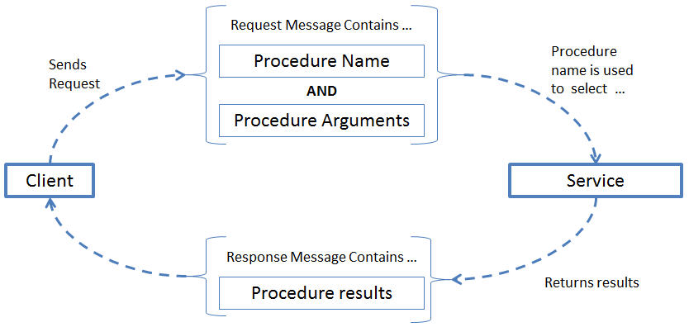
Introduction to RPC
Notes:
This picture shows some details of a complete RPC call process. Firstly, the client send a RPC request which contains procedure name and arguments to the server. Secondly the server parses the request and routes to the right procedure, and then executes the procedure, at last return the result to the client.
I think most people got the perceptual knowledge of RPC. Next i will introduce a concrete RPC library rest_rpc. I will discuss the challenges and technical details of how to implement an easy to use RPC library.

Slide 5
Outline
1.Introduction to RPC
2.What is rest_rpc?
3.Ease of use challenges
4.Key technologies
5.What can you do with it?

Slide 6
Existing RPC frmework
grpc from google
helloworld.proto
service Greeter {
rpc SayHello (HelloRequest) returns (HelloReply) {}
}
grpc server:
class GreeterServiceImpl final : public Greeter::Service {
Status SayHello(ServerContext* context, const HelloRequest* request,
HelloReply* reply) override {
std::string prefix("Hello ");
reply->set_message(prefix + request->name());
return Status::OK;
}
};
Need to define a protocol file
Strict limits
No freedom

Slide 7
Problems of some RPC library
Problems :
need to define a protocol file, complication and high learning cost
many restrictions, must inherit, no freedom
just only support one protocol, how about json, xml, custom protocol?
you should know many details of framework and network

Slide 8
What is rest_rpc
rest_rpc is an open source RPC library
link: https://github.com/topcpporg/rest_rpc
easy to use
rapid development
similar to rest api
No protocal file
No limits
Notes:
The compelling value proposition of the rest_rpc library is its focus on business logic and simplifying the calling code. Callers spend no time on networking details or data packing and unpacking.
Here are features of rest_rpc.
I’ll show you some examples about rest_rpc include client and server code.

Slide 9
What is rest_rpc
live demo
finish a RPC application in 5 minutes.

Slide 10
What is rest_rpc
client code:
// Defines the call protocol, check the grammar at compile time
TIMAX_DEFINE_PROTOCOL(add, int(int, int));
int main()
{
// Define synchronous client and msgpack serialization
rpc::sync_client<msgpack_codec> client;
//RPC request contains service name and arguments
auto endpoint = timax::rpc::get_tcp_endpoint("127.0.0.1", 9000);
auto result = client.call(endpoint, add, 1, 2);
assert(result == 3);
}
Notes:
Firstly you need define a micro contains service name, arguments types and return type. Secondly determine the serialization type, contains json, xml and msgpack format. finally call directly just like local call.
So you just need five lines code to finish the client RPC call. it’s very simple. rest_rpc of course support async call. Let’s look at the server code.
about the serialization I used a serialization engine iguana which is based on compile time reflection. I won’t talk about it this time, if you have interesting please look at my github.
about the micro I will talk about it later.

Slide 11
What is rest_rpc
server code:
//business logic
int add(int a, int b)
{
return a + b;
}
int main()
{
//define serialization type, support json, xml, msgpack
using server_t = rpc::server<rpc::msgpack_codec>;
server_t server{ port, pool_size, std::chrono::seconds{ 2 } };
server.register_handler("add", add); //register business handler
server.start();
}
Notes:
The server side code is also very simple, firstly define the serialization type, for example json, xml, msgpack formats, Secondly register business logic handler, and then you have provided a RPC service-add.
the register_handler interface is very flexible, support callable, you can register free function, lambda, member function, function object and so on.
From the example you can find both the client and the server need do very little things. the server just need register the business logic handler, and the client just need call with arguments.in a word the user just need focus on business, and needn’t care about anything else. So you can rapidly develop your application, this embodies the compelling value proposition of the rest_rpc , focus on business logic and simplifying the calling code.
Is it easy to use? You have to solve some problems to achieve easy to use goal. I’m glad to discuss how to archive the goal.

Slide 12
Outline
1.Introduction to RPC
2.What is rest_rpc
3.Ease of use challenges
4.Key technologies
5.What you can do with it
Notes:
OK I will discuss the challenges of easy to use

Slide 13
Challenges
How to register callable of any signature
How to route to the correct handler
How to simplify the call code
Notes:
The sever code is very simple, because you can easily register callable of any signature with a simple interface register_handler. you know there is no such a container which can hold different kinds of signatures in c++.
So how to register callable of any signature is the first challenge.
The second challenge is how to route the correct handler, because the request format from the client is binary data, you need to parse the string and finish a function call. so how to transform string arguments to real arguments?
The third challenge is simplify the call code, general, simple and powerful user interface is a challenge.
the last challenge is hide the details of serialization and networking, let users focus on the business logic.
ok let’s discuss the challenges now.

Slide 14

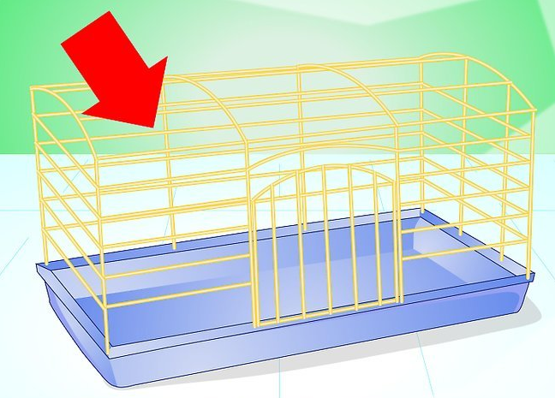
Challenges

Slide 15
Outline
1.Introduction to RPC
2.What is rest_rpc?
3.Ease of use challenges
4.Key technologies
5.What can you do with it?
Notes:
OK I will discuss the challenges of easy to use

Slide 16
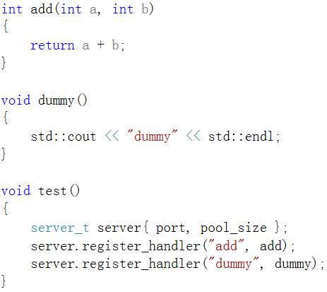
Register callable of any signature
different kinds of functions
in a same container
Notes:
rest_rpc can register different kinds of callable, no matter different return types and arguments types.

Slide 17
Register callable of any signature
C++ has no such a container
type erase
Notes:
does someone has some ideas to solve the problem? we can discuss it. let’s go on. indeed we need type erase. how to type erase? std::function? no, because the signature is fixed at the time of definition.
how about boost::variant or std::variant from c++17? no, because the variant type is also fixed at the time of definition.
how about boost::any or std::any from c++17? no, because any_cast need a concrete type to get the value, but the request from the client is binary format and lost the type information, the server has no opportunity to get the concrete type.
Now let’s look at a special type erase way implemented by modern c++.

Slide 18
Type erase
No!
The number of types is limited

Slide 19
Type erase
No!
can’t any_cast
lost type information
modern c++ can solve the problem

Slide 20
Register callable of any signature
A special type erase
template<typename Function>
struct invoker
{
static inline void apply(const Function& func, char const*, size_t){}
};
carry function type information
can accept any callable
return type
arguments type
reference
const volatile
……
int
int&
int&&
const int&
……

Slide 21
Register callable of any signature
struct server_t{
template<typename Function>
void register_handler(std::string const & name, const Function& f){
using std::placeholders::_1;
using std::placeholders::_2;
this->invokers_[name] = { std::bind(&invoker<Function>::apply, f, _1, _2)
};
private:
std::map<std::string, std::function<void(char const*, size_t)>> invokers_;
};
invoker<Function>::apply
Notes:
now you can register callable of any signature.
can accept any function
compose wrapper function and real function by std::bind
template class and std::bind erase function type

Slide 22
Register callable of any signature
type erase
std::bind(&invoker<Function>::apply, f, _1, _2)

Slide 23
Register callable of any signature
server_t server;
server.register_handler("add", [](int a, int b) {return a + b; });
server.register_handler("dummy", []{ });
server.register_handler("get_str", [](double v) { std::to_string(v); });

Slide 24

How to route
Notes:
joke, way to aspen.

Slide 25
How to route to the correct handler
template <typename CodecPolicy>
struct server_t{
template<typename Function>
void register_handler(std::string const & name, const Function& f){
using std::placeholders::_1;
using std::placeholders::_2;
this->invokers_[name] = { std::bind(&invoker<CodecPolicy, Function>::apply, f, _1, _2) };
}
void route(const std::string handler_name, char const* data, size_t size) const{
auto it = invokers_.find(handler_name);
it->second(data, size);
}
private:
std::map<std::string, std::function<void(char const*, size_t)>> invokers_;
};
Notes:
the handler name can be got easily from client request. the route function is very easy, just find the handler and then call it with binary data.
the key Point is the called handler, let’s look at it.

Slide 26
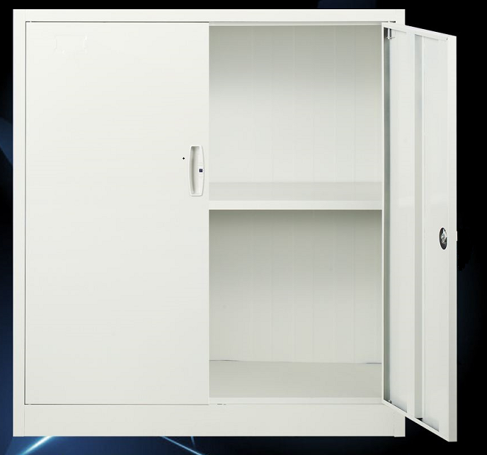

How to route to the correct handler

Slide 27
How to route to the correct handler
template<typename CodecPolicy, typename Function>
struct invoker{
static inline void apply(const Function& func, char const* data, size_t size) {
CodecPolicy cp{};
auto args_tuple = cp.template unpack<args_tuple_type>(data, size);
std::apply(func, args_tuple);
}
};
//from C++17
Notes:
the apply function has three arguments, the first argument is the registered handler, the rest arguments are binary data from client.
the client put the call arguments into a tuple and serialize it into binary data. so at the server side we need to deserialize it into tuple. I use serialization engine iguana do the work, because of the time limit I don’t want to talk about it this time.
Now you have had the registered handler and the tuple arguments, you just need to call std::apply to excecute the hander in c++17. But for C++14 you can utilize some new features to implement similar std::apply.

Slide 28
How to route to the correct handler
struct json_codec{
template <typename T>
T unpack(char const* data, size_t length){
T t;
iguana::json::from_json(t, data, length);
return t;
}
};
iguana::msgpack::from_msgpack(t, msg_, data, length);
iguana::xml::from_xml(t, data, length);
https://github.com/qicosmos/iguana

Slide 29
How to route to the correct handler
template <class F, class Tuple, std::size_t... I>
constexpr decltype(auto) apply_impl(F &&f, Tuple &&t, std::index_sequence<I...>)
{
return std::forward<F>(f)(std::get<I>(std::forward<Tuple>(t))...);
}
template <class F, class Tuple>
constexpr decltype(auto) apply(F &&f, Tuple &&t)
{
return apply_impl(std::forward<F>(f), std::forward<Tuple>(t),
std::make_index_sequence<std::tuple_size<std::decay_t<Tuple>>::value>{});
}
implemented by C++14
Notes:
we can implement std::apply by c++14, we can utilize c++14 feature std::index_sequence to expand variadic template.
at first make a index_sequence by tuple_size, then get all elements of tuple by expanding variadic template, the got parameters become function arguments and the function call finish.
ok let’s look back the solution of register and route handler

Slide 30
How to route to the correct handler
template <typename CodecPolicy>
struct server_t{
template<typename Function>
void register_handler(std::string const & name, const Function& f){
using std::placeholders::_1;
using std::placeholders::_2;
this->invokers_[name] = { std::bind(&invoker<CodecPolicy, Function>::apply, f, _1, _2) };
}
};
template<typename CodecPolicy, typename Function>
struct invoker{
static inline void apply(const Function& func, char const* data, size_t size) {
CodecPolicy cp{};
auto args_tuple = cp.template unpack<args_tuple_type>(data, size);
std::apply(func, args_tuple);
}
};
Notes:
we utilize a template class to hold the function type and wrapper the real function by invoker::apply. this is a special type erase method, we can register callable of any signature by this method.
is this method universal? yes, this method is particularly suitable for the following scenarios: parse parameters from network and route to the right handler, RPC, http server can enjoy the benefit of this method.
let’s talk about the http server

Slide 31
How to route to the correct handler
How about url?
url: "hello/test/20"
string to function call
function: void hello("test", 20)
magic

Slide 32
How to route to the correct handler
void add(int a, int b){
std::cout << a + b << std::endl;
}
void foo(std::string b, int a){
std::cout << b << std::endl;
}
router r;
r.register_handler("add", &add);
r.register_handler("fun", &foo);
string s1 = "add/1/2"; //url from client
string s2 = "fun/test/1";
r.route(s1); //route and execute
r.route(s2); //route and execute
Notes:
how to parse the string url and call the right handler, this situation is a little different from former situation, because the request is raw string, no serialization. how to route and execute by the string url?
can anyone give a solution?
the solution is similar

Slide 33
How to route to the correct handler
struct token_parser{
std::vector<std::string> v_;
static std::vector<std::string> split(std::string& s, char seperator){
//... spilt url into v_
}
template<typename T>
std::decay_t<T> get(){
auto it = v_.begin();
auto result = boost::lexical_cast<result_type>(*it);
v_.erase(it);
return result;
}
};
Notes:
Firstly split url into a string vector, the vector hold the string parameters. token parser to the work.
the get method transforms a parameter to a gave type parameter.
it’s easy and clear, nothing more to say. next we will implement route and execute by the string vector

Slide 34
How to route to the correct handler
struct router
{
template<typename Function>
void register_handler(std::string const & name, const Function& f)
{
using std::placeholders::_1;
this->invokers_[name] = std::bind(&invoker<Function>::template apply<std::tuple<>>, f, _1, std::tuple<>());
}
private:
typedef std::function<void(token_parser &)> invoker_function;
std::map<std::string, invoker_function> invokers_;
};
Notes:
Pay attention to the bind, this time we also bind static member function of a template class, but the member function is template function, and one argument is a empty tuple. let’s look at the template class.

Slide 35
How to route to the correct handler
template<typename Ret, typename... Args>
struct function_traits_impl<Ret(Args...)>{
enum { arity = sizeof...(Args) };
typedef Ret result_type;
using stl_function_type = std::function<function_type>;
template<size_t I>
struct args{
static_assert(I < arity, "index is out of range");
using type = typename std::tuple_element<I, std::tuple<Args...>>::type;
};
};
template<typename T>
struct function_traits : function_traits_impl<
std::remove_cv_t<std::remove_reference_t<T>>>{};
https://github.com/topcpporg/rest_rpc/blob/master/rest_rpc/base/function_traits.hpp
Notes:
we need some helper class, for example function_traits, it used to trait function return type, arguments types, arguments number and so on.
this is a part of function_traits, more details you can find it here:https://github.com/topcpporg/rest_rpc/blob/master/rest_rpc/base/function_traits.hpp.
this function_traits help us a lot, let’s go on.

Slide 36
How to route to the correct handler
template<typename Function, size_t N = 0, size_t M = function_traits<Function>::arity>
struct invoker{
template<typename Args>
static void apply(const Function& func, token_parser parser, Args const & args){
typedef typename function_traits<Function>::template args<N>::type arg_type;
router::invoker<Function, N + 1, M>::apply(func, parser,
std::tuple_cat(args, std::make_tuple(parser.get<arg_type>())));
}
};
Notes:
the first invoker class is the base case, has three template arguments, the first argument is the type of registered handler, the second template argument N, every time plus 1 in recursive process, and the third argument is the termination condition. pay attention to the red color code, Firstly every time get a string argument and transform it to corresponding argument in the function. Secondly put the transformed argument into the empty tuple by tuple_cat, because the beginning args is std::tuple<>, so we need tuple_cat argument one by one, at last we get all arguments in a tuple when recursive determined, and we can use std::apply to finish call with tuple.
the key point is transform string argument one by one and add it into a tuple, at last apply with registered function and tuple arguments. is that clear?
I think it’s very difficult to solve the problem by c++03
but it’s easy for modern c++, because there are so many new features can help us, we just need find the potential of new features and compose them together.

Slide 37
template<typename Function, size_t M>
struct invoker<Function, M, M>{
template<typename Args>
static void apply(const Function& func, token_parser &, Args const & tuple){
std::apply(func, tuple);
}
};
https://github.com/qicosmos/cosmos/blob/master/router.hpp

Slide 38

Cut the complexity

Slide 39
How to simplify the call code
struct foo_t{
int add(int a, int b){
return a + b;
}
};
foo_t foo = {};
server.register_handler("foo_add", timax::bind(&foo_t::add, &foo));
timax::bind(&foo_t::add, &foo);
timax::bind(&foo_t::add, &foo, std::placeholders::_1, std::placeholders::_2);
//bind without anything, clean code
Notes:
pay attention to the timax bind, let’s compere it with std::bind.
timax::bind omits placeholder , it’s more simple.
timax bind is not another bind, it’s just a wrapper of std::bind for simplify the usage, let’s look at the implementation.

Slide 40
How to simplify the call code
template <typename F, typename Arg0, typename ... Args>
auto bind_impl(F&& f, Arg0&& arg0, Args&& ... args)
-> typename bind_to_function<F, Arg0, Args...>::type
{
return std::bind(std::forward<F>(f), std::forward<Arg0>(arg0), std::forward<Args>(args)...);
}
template <typename F>
auto bind_impl(F&& f) -> typename function_traits<F>::stl_function_type
{
return [func = std::forward<F>(f)](auto&& ... args){
return func(std::forward<decltype(args)>(args)...);
};
}
Notes:
there are two overload functions, if you bind with parameters, the first function was selected, in the function std::bind is called, if you omit the parameters, the second function will be selected.
Here we use move capture lambda, and the return type is std::function.

Slide 41
How to simplify the call code
namespace client
{
TIMAX_DEFINE_PROTOCOL(add, int(int, int));
}
asycn_client.call(endpoint, client::add, 3, 5);
asycn_client.call(endpoint, client::add, "test", 5); //compile error, not matching
No protocol file
call protocol is very easy to understand
How to check call error at compile time?
Notes:
Pay attention to the micro TIMAX_DEFINE_PROTOCOL, it’s a call protocol. You know many kinds of servers use protocol buffer or some other protocol file to define the call protocol. I don’t like the way, I think the protocol file increase learning cost, you have to learning the complicated details and there is no unified protocol. So rest_rpc discards protocol file, rest_rpc want user just need focus on business and easy to use. So we use a universal micro to define call protocol. maybe you have lots of reasons and benefits of protocol file, but rest_rpc want to provide a new way, a simple way, a modern c++ way to solve the problem of call protocol.
if we check the arguments at server side, it’s too late, so we want to check the arguments as easily as possible, TIMAX_DEFINE_PROTOCOL help us to check arguments at compile time.

Slide 42
How to simplify the call code
#define TIMAX_DEFINE_PROTOCOL(handler, ...) static const rpc::rpc_protocol<__VA_ARGS__> handler{ #handler }
template <typename Ret, typename ... Args>
struct rpc_protocol<Ret(Args...)>{
using signature_type = Ret(Args...);
template <typename ... TArgs>
auto pack_args(TArgs&& ... args) const{
static_assert(is_argument_match<signature_type, TArgs...>::value, "don`t match the protocol!");
}
};
is_argument_match<signature_type, TArgs...>::value
TIMAX_DEFINE_PROTOCOL(add, int(int, int));
rpc_protocol<int(int, int)> add;
Notes:
we utilize the micro traits the function type include return type , arguments, and then define an object, the object name is literal hander. look at the rpc_protocal class, the first template argument is return type, the rest arguments are variadic template, and then we can easily get the signature type. pay attention to the is_argument_mactch, this trait will check the rpc call parameters with signature at compile time, if they match, the value is true, otherwise static_assert occur. So we can check the rpc call at compile time. let’s look at the trait is_argument_match.

Slide 43


Is matching
is matching?

Slide 44
How to simplify the call code
template <typename Func, typename ... Args>
struct is_argument_match
{
private:
template <typename T>
static std::false_type test(...);
template <typename T, typename =
decltype(std::declval<T>()(std::declval<Args>()...))>
static std::true_type test(int);
using result_type = decltype(test<Func>(0));
public:
static constexpr bool value = result_type::value;
};
is matching?
declval, decltype,
Pretend to call,
according to SFINAE
decltype(std::declval<T>()(std::declval<Args>()...)
Notes:
if signature and arguments are matching, the result_type is true_type, other wise false_type.
I like this way to check if the signature and arguments match by decltype and declval, sometimes we use this way to check if exist a method in a class. for example we can check a template argument if is a smart pointer

Slide 45
How to simplify the call code
is_smart_pointer
static_assert(is_smart_pointer<std::shared_ptr<int>>::value, "error"); static_assert(is_smart_pointer<std::unique_ptr<int>>::value, "error"); static_assert(is_smart_pointer<int*>::value, "error"); //compile error
Notes:
this is the test code to test is_smart_pointer, if the type is not std::shared_ptr or std::unique_ptr, compile error will occur.

Slide 46
How to simplify the call code
template <typename T, typename = void>
struct is_smart_pointer : std::false_type
{
};
// this way of using SFINEA is type reference and cv qualifiers immuned
template <typename T>
struct is_smart_pointer<T,
std::void_t<decltype(std::declval<T>().operator ->()),
decltype(std::declval<T>().get())>> : std::true_type
{
};
std::void_t C++17
not in C++14
Notes:
if T have method -> and get, we can think it is a smart pointer, of course you can add more methods int coma expression to increase the verification.

Slide 47
How to simplify the call code
template <typename T, typename = void>
struct is_smart_pointer : std::false_type
{
};
// this way of using SFINEA is type reference and cv qualifiers immuned
template <typename T>
struct is_smart_pointer<T,
std::void_t<decltype(std::declval<T>().operator ->()),
decltype(std::declval<T>().get()
>> : std::true_type
{
};
, decltype(std::declval<T>().reset())
Notes:
but std::void_t is a features of c++17, not in c++14, if you want to use this way in c++14, you just need to make a void_t.

Slide 48
How to simplify the call code
What can we do with void_t?
Simplify the way of using SFINAE
Immune to reference and cv qualifiers
Notes:
but std::void_t is not in c++14, if you want to use this way in c++14, you just need to make a void_t.

Slide 49
How to simplify the call code
voider ultility
template <typename ... Args>
struct voider
{
using type = void; };
template <typename ... Args>
using voider_t = typename voider<Args...>::type;
C++14 surpport void_t now
C++11 do not deduce Args… type
Notes:
in c++14 you can use this void_t like c++17.
Pay attention, this void_t is just fit for c++14, not c++11.
Until C++14 unused parameters in alias templates were not guaranteed to ensure SFINAE and could be ignored.

Slide 50

Something more

Slide 51
How to simplify the call code
some points about RPC and pub/sub model
RPC is a special pub/sub.
pub/sub is a special RPC
RPC model and sub/pub model have the common essence
Notes:
RPC is a special pub/sub, for RPC, the publisher and the subscriber are the same one.
pub/sub is a special RPC, the requester and the responser are the same one.
So we not only support RPC but also support pub/sub. you know the two models are very common, rest_rpc mixed the two models, you can use the two models freely. for example.

Slide 52
How to simplify the call code
// the interface is type safe and non-connect oriented designed
asycn_client.call(endpoint, client::add, 1, 2).on_ok([](auto r) {
std::cout << r << std::endl;
}).on_error([](auto const& error){
std::cout << error.get_error_message() << std::endl;
}).timeout(1min);
asycn_client.sub(endpoint, client::sub_add, [](auto r){
std::cout << r << std::endl;
},[](auto const& error) {
std::cout << error.get_error_message() << std::endl;
});
async_client->pub(endpoint, client::sub_add, rhs);
call
sub
pub
Notes:
you can use the two models at the same time, it’s very convenient and flexible.

Slide 53



Slide 54
Outline
1.Introduction to RPC
2.What is rest_rpc?
3.Ease of use challenges
4.Key technologies
5.What can you do with it?

Slide 55
rest_rpc can be used to do what
Interprocess communication
Distribute system
HA(binary star, raft)
Service discovery
Message queue
Distribute compute
Distribute storage

Slide 56
Links
https://github.com/topcpporg/rest_rpc
http://purecpp.org/
Contact me: qicosmos@163.com

Slide 57
Questions?

